Slide 1
Superpixels
Ganiyu Ibraheem & Philipp Seybold
Advanced Computer Vision
Group A3

Slide 2
Overview
Introduction
Definition & Properties
Applications
Approaches
State-Of-The-Art (Maybe also Ganiyu?)
Demonstration
Discussion
Ganiyu, Philipp

Slide 3
Introduction
Firstly introduced by Xiaofeng Ren and Jitendra Malik in: “Learning a Classification Model for Segmentation”
First Superpixel algorithms around 2009
Fast expansion until now into nearly all Computer Vison domains
Notes:
Firstly introduced by Xiaofeng Ren and Jitendra Malik in their paper (but superpixel-like segmentation was applied already before): Learning a Classification Model for Segmentation
Goal: Classification model for Segmentation accuracy
Drew attention through good results and holding its promises
First algorithms around 2009

Slide 4
Definition
Group perceptually similar pixels (e.g. colour) to create visually meaningful entities
Heavily reducing the number of primitives for subsequent processing steps
Often equally treated as oversegmentaion algorithms
Notes:
Superpixels group perceptually similar pixels (e.g. colour) to create visually meaningful entities while heavily reducing the number of primitives for subsequent processing steps.
The high number of pixels in images make then unfeasible computationally and images are a discretization of the continuous reality (why is that a problem though?)
Often equally treated as oversegmentaion algorithms (but number of Superpixels settable)

Slide 5
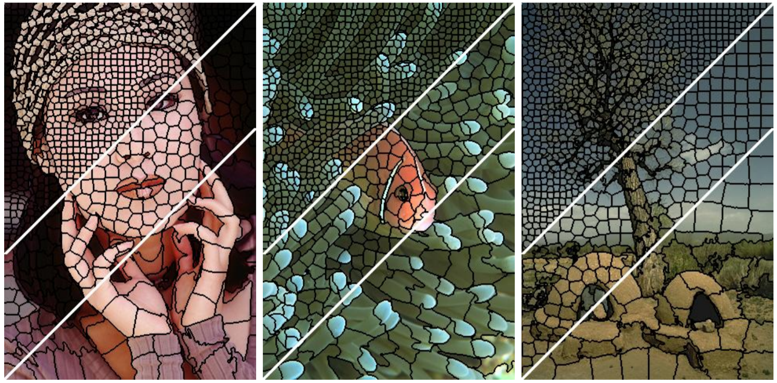
Definition
Example (SLIC)
Notes:
number of Superpixels settable

Slide 6
Properties
Partition
Connectivity
Boundary adherence
Compactness, Regularity and Smoothness
Efficiency
Controllable number of Superpixels
Notes:
Partition: They should define a partition on the image (disjoint and labelled)
Connectivity: Connected set of pixels
Boundary adherence: Preserve image boundaries
Compactness, Regularity and Smoothness (if no boundaries)
Efficiency
Controllable number of Superpixels

Slide 7
Applications
Tracking
Stereo and occlusion
3D-Reconstruction
Object detection
Depth recovery & estimation
Semantic segmentation
Optical & scene flow
…
Notes:
Tracking
Stereo and occlusion
3D-Reconstruction
Saliency
Object detection
Object proposal detection
Depth recovery
Depth estimation
Semantic segmentation
Indoor scene understanding
Optical flow
Scene flow
Clothes parsing
Basis for CNNs

Slide 8
Approaches
Watershed-based
Density-based (EAMS)
Graph-based (ERS)
Contour-Evolution (ERGC)
Path-based
Clustering-based (SLIC)
Energy Optimisation (SEEDS, ETPS, CRS)
Wavelet-based
Notes:
Watershed-based e.g Compact Watershed, Water Pixels
Density-based e.g Edge-Augmented Mean Shift (EAMS), Quick Shift etc - usually classified as over-segmentation algorithms
Graph-based e.g Normalised cuts, Constant Intensity Superpixels, ERS
Contour-Evolution e.g Turbo Pixels, ERGC (fast)
Path-based e.g Path Finder, Topology Preserving Superpixels
Clustering-based e.g SLIC (Simple Linear Iterative Clustering), Depth Adaptive Superpixels, Preemptive SLIC, Voxel-Cloud Connectivity Segmentation (VCCS, usually used for point cloud)
Energy Optimisation e.g SEEDS (Superpixels extracted via energy-driven sampling), ETPS (Extended Topology Preserving Segmentation), CRS
Wavelet-based e.g Superpixels from Edge avoiding wavelets (SEAW)
The main differences are in the objective function they minimize and in the optimization technique that performs the minimization.
These are typically based on agglomerative clustering in the color domain [9, 12, 14], k-means style energy optimization [1], and coarse-to-fine optimization [7, 8]

Slide 9
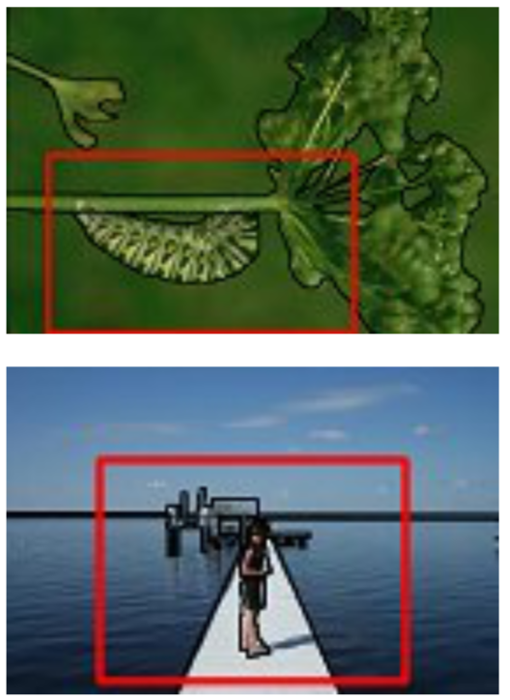
Evaluation on different datasets
These algorithms were further evaluated on 3 datasets; 2 outdoor and 2 indoor for comparison and 1 person dataset
Outdoor datasets
Berkeley Segmentation Dataset
500 Images
5 High Quality ground truth segmentations per image
Stanford Background dataset
Contains 715 images
More complex scenes than the Berkeley segmentation dataset
Notes:
These datasets reflect the common applications except in the field of medical applications where superpixels are really common. They also should reflect the same results one would achieve from a populat dataset like ImageNet
The Berkeley dataset contains simple outdoor scenes, showing landscape, buildings and animals where foreground and background are easily identified.

Slide 10
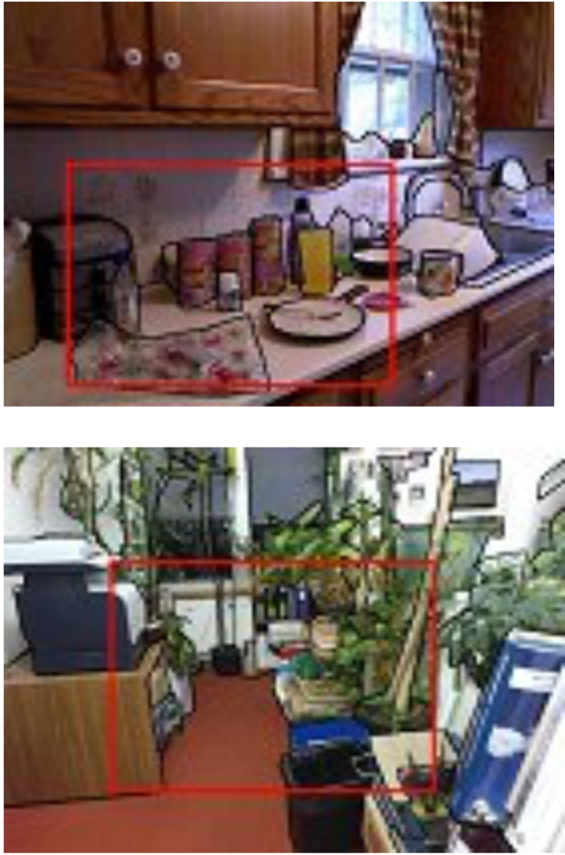
Evaluation on different dataset
Indoor datasets
NYU Depth Dataset v2
1449 images including depth data
Dataset not as complex as the Berkeley
dataset but contains a diverse range of
indoor scenes from private to commercial
accommodations
SUN RGB-D dataset
10335 images including depth data
Contains lots of images with cluttered scenes with bad lighting conditions
Notes:
The NYU Depth dataset was captured using a Microsoft Kinect
The SUN RGB-D dataset was captured using a Kinect v1 and v2, Intel Realsense and Asus Xtion

Slide 11
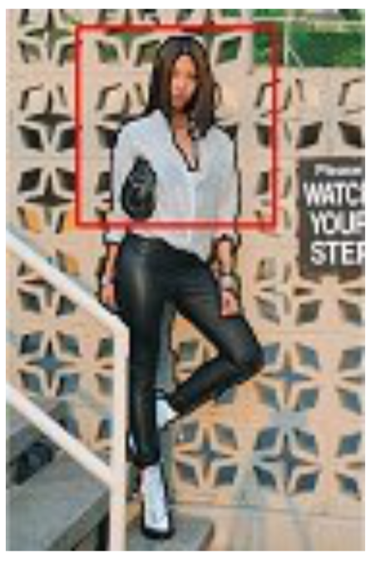
Evaluation on different datasets
Person dataset
The FASH (Fashionista) dataset
685 Images showing the full body of fashion bloggers
Previously used for clothes parsing annotated; leveraged the Amazon mechanical turk platform for semantic ground-truth data

Slide 12
Evaluation on different datasets
Is Depth Necessary for Image segmentation?

Slide 13
State-Of-The-Art
Edge-Augmented Mean Shift (EAMS)
…
Entropy-Rate-Superpixel (ERS)
…
Simple Linear Iterative Clustering (SLIC)
iterative k-means style clustering
Extended Topology Preserving Segmentation (ETPS)
Efficient joint segmentation, occlusion labelling, stereo and flow estimation
Uses coarse-to-fine energy update strategy

Slide 14
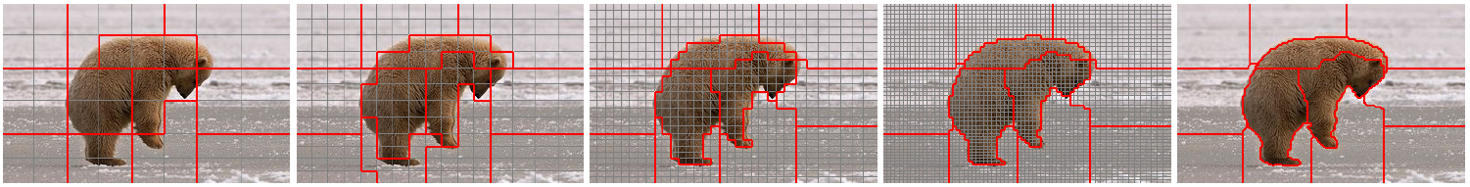
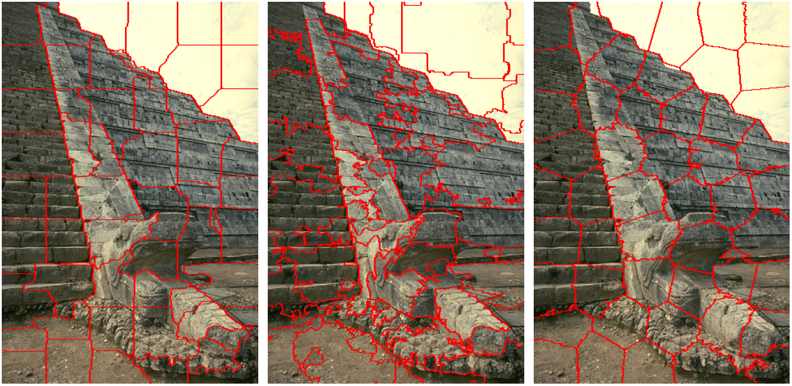
Extended Topology Preserving Segmentation (ETPS)
Notes:
“In this paper, we build on [31] (K. Yamaguchi, D. McAllester, and R. Urtasun. Efficient joint segmentation, occlusion labeling, stereo and flow estimation. In ECCV, 2014.) and propose a much more efficient optimization algorithm that results in an order of magnitude less updates (speed-up). Inspired by the SEEDS algorithm [8] our method uses a coarse-to-fine energy update strategy, which allows the optimization to reach better energy minima than [31] when employing even a single iteration.”

Slide 15
Extended Topology Preserving Segmentation (ETPS)
Rectangular grid
Init + For level:
Compute mean color (center) and mean position
For iter:
Get all boundary blocks on level
While list != empty:
Valid connectivity block i -> minimize Energy function to find block best suitable block
If new block is different from old one:
Update center and means for the two blocks and
Add i’s neighbours to block list end
Notes:
Energy function: Objective function similar to kmeans clustering, where we want Superpixels that are coherent in appearance but that have also regular shape. We additionally add constraints on the size of the Superpixel to prevent tiny Superpixels.

Slide 16
Extended Topology Preserving Segmentation (ETPS)
E pos = Shape Regularization (should be regular in shape)
E col = Appearance Coherence (encourage color homogeneity)
E b = Boundary Length (encourage small boundary length)
E topo = Topology Preservation (focuses a connected component)
E size = Minimum size (size needs to be at least ¼ of their initialization size)

Slide 17

Extended Topology Preserving Segmentation (ETPS)
E mon = $Σ_{p} E_{col}+E_{pos}+Σ_{p,N_{8}}E_{b}+E_{topo}+E_{size}$

Slide 18
Demonstration
Live Demo (Extended Topology Preserving Segmentation)
Donald Trump
Compare 3 methods At least 1 life feed

Slide 19
Result
Performance of different approaches depends on application and correct parameterization
State-of-the-art methods for a variety of problems with great results
Only a few real-time performing approaches
Fast-paced field within computer vision

Slide 20
Sources
[1] | Learning a Classification Model for Segmentation
[2] | Superpixels: An Evaluation of the State-of-the-Art
[3] | Real-Time Coarse-to-fine Topologically Preserving Segmentation
[4] | …

Slide 21
Work distribution
Equal workload for both group members in every part of the project with different focusses for the presentation:
Ganiyu | Implementation of stream feature and work on both approaches for the force field transformation; focused on math for implementation part
Philipp | Worked on both approaches when issues occurred and provided comparisons to other implementations; focused on theory of the approach as a whole

Slide 22

Discussion
Any Questions?

